Slide 1

Sustainability and Ethics in Strategic Decision-Making

Slide 2

Sustainability & decision-making
Discover (Lecture plan)
Learning aims
Sustainability and ethics: issues
Accounting for wider stakeholders
Extended business model canvas
Share & apply (Seminar plan)
Recap of lecture: key concepts
Activity 1: Bring me news
Activity 2: Case study -Unilever and Sundial brands
Summary & link to assessment

Slide 3
Learning objectives
Identify sustainability and ethics issues in strategic decision-making (beyond financial capital);
Apply sustainability and ethics issues and strategic methods to ‘real’ industries and organisations; and
Identify strategic measurements in accounting for wider stakeholders.

Slide 4






INTERNATIONAL CORPORATE FINANCE
Equity Debt Credit
FINANCIAL CAPITAL
HUMAN/INTELLECTUAL CAPITAL
SOCIAL/RELATIONSHIP CAPITAL
STRATEGIC INVESTMENT APPRAISAL
Business Units, Projects & Activities
MANUFACTURED CAPITAL
NATURAL/ENVIRONMENTAL CAPITAL
Scorecards, Key performance indicators & Budgets
FINANCIAL PERFORMANCE MANAGEMENT
GLOBAL FINANCIAL MANAGEMENT

Slide 5
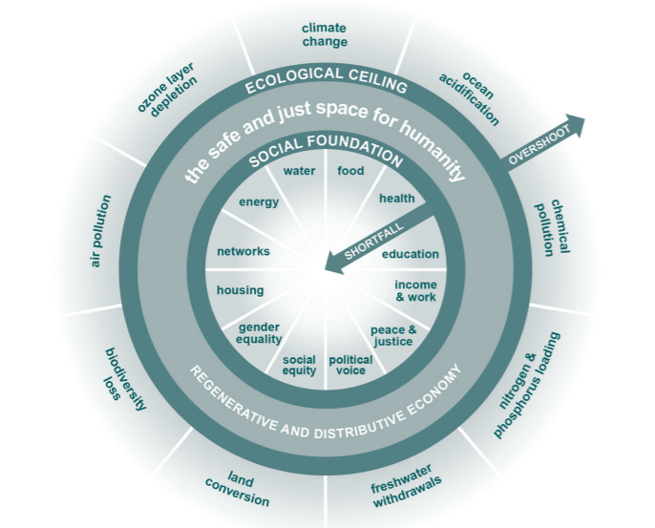
Sustainability and ethics: issues (1/2)
The realization of the Sustainable development goals (UN SDGs, 2015) should lead to the creation of a “safe and just space for humanity” (Raworth, 2017)
The Doughnut of Social and Planetary Boundaries, Raworth (2017)
General issues | Financial reporting and corporate governance | Sustainability issues
Default and bankruptcy | Earnings management | Accountability
Market manipulation and insider trading | Tax avoidance | Environmental issues
Renumeration | Agency | Social and political issues
Fraud and corruption | Executive remuneration | Globalisation
Negligence, recklessness and poor judgement | Passive regulators | Raw materials and natural resources

Slide 6
Sustainability and ethics: issues (2/2)
General issues | Financial reporting and corporate governance | Sustainability issues
Default and bankruptcy | Earnings management | Accountability
Market manipulation and insider trading | Tax avoidance | Environmental issues
Renumeration | Agency | Social and political issues
Fraud and corruption | Executive remuneration | Globalisation
Negligence, recklessness and poor judgement | Passive regulators | Raw materials and natural resources
Hendry (2013)
PWC (2019)

Slide 7

Accounting for wider stakeholders
Two major forms of measurement:
1. High level qualitative summaries
The Global Impact Investing Network (GIIN)
Annual report analysis
2. Quantitative ESG-related metrics
GIIN
The MultiCapital scorecard (Thomas & McElroy, 2016)
Sustainability Assessment Model (Bebbington, 2007)
The eBMC analysis grid (Walkiewicz et al., 2021)

Slide 8
Example of a MultiCapital Scorecard
Thomas & McElroy, 2016, p.104

Slide 9
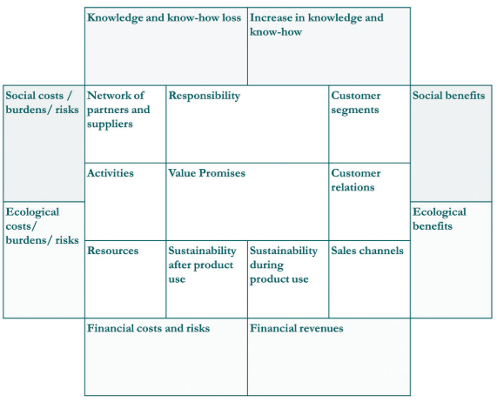
Extended business model canvas (eBMC)
CSR should be a part of the core business model and permeate into strategic decision making (Galbreath, 2006)
Adding non-financial dimensions to a traditional BMC ensures it will be a sustainable BMC, integrating sustainability and externalities into the corporate DNA (Walkiewicz et al., 2021)
The extended business model canvas (Walkiewicz et al., 2021)
General issues | Financial reporting and corporate governance | Sustainability issues
Default and bankruptcy | Earnings management | Accountability
Market manipulation and insider trading | Tax avoidance | Environmental issues
Renumeration | Agency | Social and political issues
Fraud and corruption | Executive remuneration | Globalisation
Negligence, recklessness and poor judgement | Passive regulators | Raw materials and natural resources

Slide 10
Summary
Area covered | Summary
Sustainability and ethics: issues | Issues can range from general to more specific issues in financial reporting, corporate governance and sustainability.
Accounting for wider stakeholders | Stakeholder consideration is key in strategic decision making. Measurements may be qualitative or quantitative.
Extended business model canvas | Sustainability and ethics issues play a crucial part of the core business model and permeate into strategic decision making.
In the news | No industry or company is exempt from the issues we’ve identified. Sustainability and ethics affect everyone in the market.
Unilever and Sundial brands case study | Constant adaptation and consideration of stakeholders is key to achieving sustainability and addressing emerging ethical issues.

Slide 11
References
Bebbington, J. (2007) Accounting for Sustainable Development Performance. Elsevier.
Busco, C., Frigo, M.L., Quattrone, P., and Riccaboni, A. (2013) Integrated reporting: Concepts and Cases that Redefine Corporate Accountability. Springer.
Galbreath, J. (2006), “Corporate social responsibility strategy: strategic options, global considerations”, CorporateGovernance: TheInternationalJournalofBusiness in Society, Vol. 6 No. 2, pp. 175-187
Hendry, J. (2013) Ethics and finance. Cambridge University Press.
Nisen, M. (2013) How Nike solved its sweatshop problem. Business Insider. Available at: https://www.businessinsider.com/how-nike-solved-its-sweatshop-problem-2013-5?r=US&IR=T [Accessed 10 March 2019].
PWC (2019) Creating a sustainable business. Available at: https://www.pwc.com/gx/en/issues/sustainability.html [Accessed 10 March 2019].
Raworth, K. (2018) Doughnut Economics : Seven Ways to Think Like a 21st-Century Economist. London: Random House Business Books.
Thomas, M.P. and McElroy, M.W. (2016) The MultiCapital Scorecard: Rethinking Organizational Performance. Chelsea Green Publishing.
Unilever plc (2017) Unilever to acquire Sundial Brands. Available at: https://www.unilever.com/news/press-releases/2017/unilever-to-acquire-sundial-brands.html [Accessed 1 March 2021].
Walkiewicz, J., Lay-Kumar, J. and Herzig, C. (2021) The integration of sustainability and externalities into the “corporate DNA”: a practice-oriented approach. Corporate Governance: The International Journal of Business in Society.

